Slide 1
NLP Sentiment Analysis
Team Members:
Akankshya Sharma
Pandhare Kalyani Dnyaneshwar
Kukatpally Harshitha
Mentors:
Varun Vennelaganti
Stephy John

Slide 2
Problem Statement
Analyzing large volumes of customer reviews manually is a challenging and time-consuming task. There is a need for an automated system that can efficiently process and classify customer feedback. This project aims to develop a sentiment analysis model to identify whether reviews are positive, neutral, or negative.

Slide 3
Objective of the Project
To perform sentiment analysis on customer reviews using NLP techniques
To categorize reviews into positive, neutral, and negative sentiments
To extract meaningful insights from customer feedback
To develop a machine learning model for automated sentiment prediction

Slide 4
Overview of the Dataset
The dataset contains customer product reviews.
It includes review text and ratings given by users.
The ratings were used to generate sentiment labels.
The sentiments are classified as positive, negative, and neutral.
The dataset was collected from e-commerce platforms.

Slide 5
Exploratory Data Analysis - Visual Insights
The dataset consists of customer reviews along with their corresponding ratings.
Initial data exploration was performed to understand the structure and key features of the dataset.
Missing values and duplicate entries were identified and handled appropriately.
The distribution of sentiment classes (positive, negative, and neutral) was analyzed using visualizations.
It was observed that the majority of the reviews are skewed towards positive sentiment.
The length of the reviews was analyzed to understand variation in text size across the dataset.
Word frequency analysis was performed to identify commonly used words in customer reviews.
Data visualization techniques such as bar charts and histograms were used to gain insights.
These insights helped in understanding patterns and preparing the data for further processing.

Slide 6
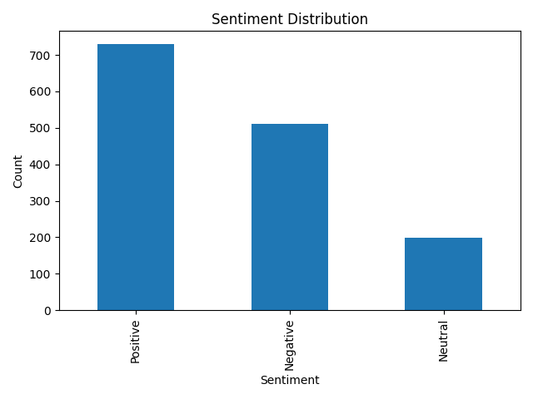
Sentiment Distribution Analysis

Slide 7
Feature Engineering
Duplicate entries were removed from the dataset to improve data quality.
The review text was converted into lowercase to maintain consistency.
Special characters and non-alphabetic values were removed using regular expressions.
The text was tokenized into individual words for better processing.
Stopwords were removed to retain only meaningful and important words.
The cleaned text was stored as a new feature for further processing.
TF-IDF vectorization was applied to convert text data into numerical form.
A feature matrix was created using the TF-IDF representation for model training.

Slide 8
Model Building and Evaluation
Naive Bayes
Target: Sentiment (Positive, Negative, Neutral) Input: TF-IDF vectorized review text Train-test Split: 80% - 20% Model Evaluation Metric: Accuracy Result: Achieved comparatively lower accuracy
Logistic Regression
Target: Sentiment (Positive, Negative, Neutral) Input: TF-IDF vectorized review text Train-test Split: 80% - 20% Model Evaluation Metric: Accuracy Result: Achieved the highest accuracy

Slide 9
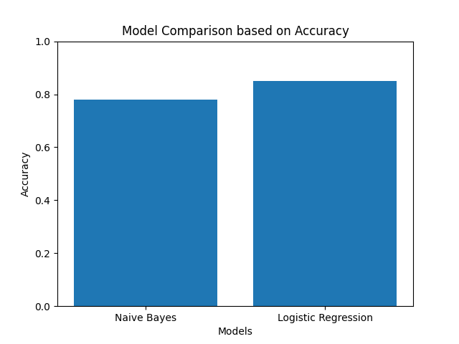
Model Comparison

Slide 10
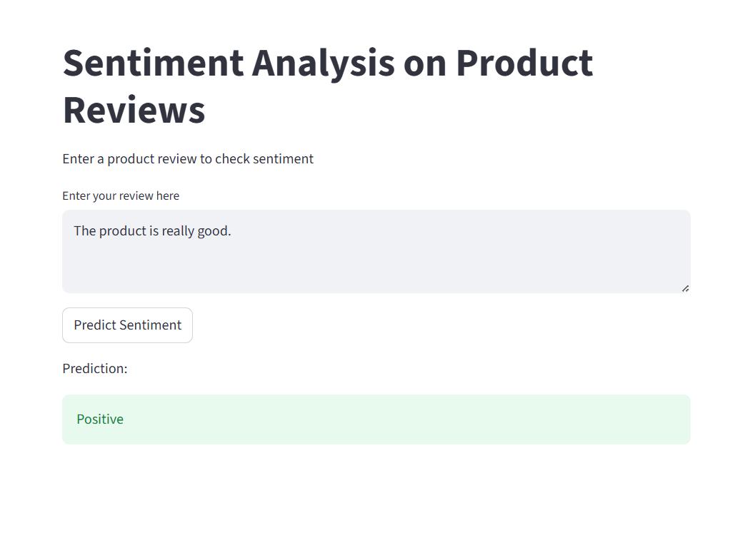
Model Deployment

Slide 11
Challenges Faced
Selecting useful features without adding noise
Handling noisy and unstructured text data
Ensuring proper preprocessing to avoid distorted results
Difficulty in identifying neutral sentiments

Slide 12
Conclusion
Successfully developed a sentiment analysis model for customer reviews.
Applied NLP techniques to preprocess and analyze text data.
Logistic Regression provided the best performance among all models.
The model can efficiently classify reviews into positive, negative, and neutral sentiments.
The deployed application enables real-time sentiment prediction.

Slide 13
THANK YOU

